Slide 1
Brain-Computer Interface
By Daniel Elstob

Slide 2
Introduction
What I want to do with this presentation is to talk about Brain-Computer Interface (BCI).

Slide 3
What is BCI
BCI is a direct communication pathway between the brain and an external device
BCI is the objective of creating applications and solutions to improve the quality of life of human beings
Notes:
1st:BCIs are often aimed at assisting, augmenting, or repairing human cognitive or sensory-motor functions.

Slide 4
BCI Signal Sources
EEG
ECoG
LFP
Single Units
Notes:
EEG-The brain is made up of about 100 billion nerve cells, or neurons, which emit an electrical impulse when interacting. The headset implements a technology known as non-invasive electroencephalography (EEG) to read the neural activity.
ECoG- Electrocorticography (ECoG) is the practice of using electrodes placed directly on the exposed surface of the brain to record electrical activity from the cerebral cortex. ECoG may be performed either in the operating room during surgery (intraoperative ECoG) or outside of surgery (extraoperative ECoG). Because a craniotmoy (a surgical incision into the skull) is required to implant the electrode grid, ECoG is an invasive procedure. ECoG is currently considered to be the “gold standard” for defining epileptogenic zones in clinical practice.
LFP- Local Field Potentials
Single Units-

Slide 5
Types of BCI
Invasive BCI
Non-invasive BCI
Partially-invasive BCI
Neuroprosthetics
Notes:
There are four different types of brain computer interfaces currently. Invasive, Non-invasive, partially-invasive and Neuroprosthetics. I will go over each type.
Invasive - A BCI that is directly implanted into the grey matter of a subject's brain via neurosurgery, produces the highest quality signals, prone to building up scar tissue
Non-invasive - Does not require surgical implantation, EEG cap to read brain’s neural signals, produces poor signals
Partially-invasive - A BCI implanted into the skull but not into the brain
Neuroprosthetics -

Slide 6
What is the current BCI
Deep Brain Stimulators
Braingate
Cochlear Implant

Slide 7
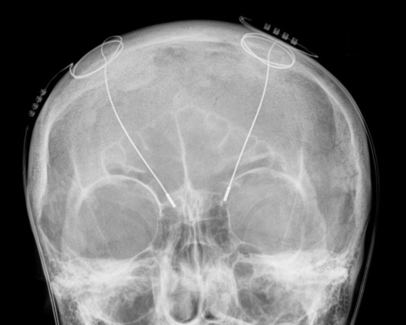
Deep Brain Stimulators
Deep brain stimulation (DBS) is a surgical treatment involving the implantation of a medical device called a brain pacemaker
DBS sends electrical impulses to specific parts of the Brain providing benefits for treatment resistant movement disorders such as;
Chronic pain
Parkinson's disease
Tremor
Dystonia
DBS directly changes brain activity in a controlled manner, its effects are reversible and is one of only a few neurosurgical methods that allows blinded studies
Notes:
Deep brain stimulation (DBS) - A surgical treatment involving the implantation of a medical device called a brain pacemaker, which sends electrical impulses to specific parts of the brain. DBS in select brain regions has provided remarkable therapeutic benefits for otherwise treatment-resistant movement and affective disorders such as chronic pain, Parkinson's disease, tremor and dystonia. Despite the long history of DBS, its underlying principles and mechanisms are still not clear. DBS directly changes brain activity in a controlled manner, its effects are reversible (unlike those of lesioning techniques) and is one of only a few neurosurgical methods that allows blinded studies.
The Food and Drug Administration (FDA) approved DBS as a treatment for essential tremor in 1997, for Parkinson's disease in 2002, and dystonia in 2003. DBS is also routinely used to treat chronic pain and has been used to treat various affective disorders, including major depression. While DBS has proven helpful for some patients, there is potential for serious complications and side effects. (Ref-(http://en.wikipedia.org/wiki/Deepbrainstimulation))
Parkinson's disease – a degenerative disorder of the central nervous system. The motor symptoms of Parkinson's disease result from the death of dopamine-generating cells in the substania nigra, a region of the midbrain; the cause of cell-death is unknown. Early in the course of the disease, the most obvious symptoms are movement-related, including shaking, rigidity, slowness of movement and difficulty with walking and gait. Later, cognitive and behavioural problems may arise, with dementia commonly occurring in the advanced stages of the disease. Other symptoms include sensory, sleep and emotional problems. PD is more common in the elderly with most cases occurring after the age of 50. (Ref-(http://en.wikipedia.org/wiki/Parkinson's disease))
Tremor - A tremor is an involuntary, somewhat rhythmic, muscle contraction and relaxation involving to-and-fro movements (oscillations or twitching) of one or more body parts. It is the most common of all involuntary movements and can affect the hands, arms, eyes, face, head, vocal folds, trunk, and legs. Most tremors occur in the hands. In some people, tremor is a symptom of another neurological disorder. A very common kind of tremor is the chattering of teeth, usually induced by cold temperatures or by fear. (Ref-(http://en.wikipedia.org/wiki/Tremor))
Dystonia - a neurological movement disorder, in which sustained muscle contractions cause twisting and repetitive movements or abnormal postures. The disorder may be hereditary or caused by other factors such as birth related or other physical trauma, infection, poisoning (e.g., lead poisoning) or reaction to pharmaceutical drugs, particularly neuroleptics. Treatment is difficult and has been limited to minimizing the symptoms of the disorder, since there is no cure available. (Ref-(http://en.wikipedia.org/wiki/Dystonia))

Slide 8
BrainGate
A chip implanted directly into the brain that detects impulses
Allows the paralysed to experience the freedom they used to have through the use of BCI
First person to have the BrainGate was Matthew Nagel, a 25 year old quadriplegic

Slide 9
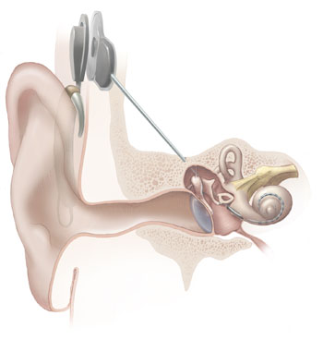
Cochlear Implant
A implant that is implanted to provide sound to a person who is deaf or severely hard of hearing
219,000 people worldwide have cochlear implants.
Notes:
1st: As of December 2010, approximately 219,000 people worldwide have received cochlear implants. The vast majority are in developed countries due to the high cost of the device, surgery and post-implantation therapy. A small but growing segment of recipients have bilateral implants (one in each ear).
A cochlear implant is an implanted device that provides a sense of sound to a person who is profoundly deaf or severely hard of hearing.
Cochlear implants can restore hearing in patients suffering deafness due to loss of sensory hair cells in their cochlea

Slide 10
Future Advancements
Direct brain-to-brain communication
Immersive virtual reality
Medical
Military
Notes:
Brain2brain – Seamless transfer of thoughts, emotions and experiences from one mind to another
Virtual Environments - Gaming, etc
Medical - restoration of vision, hearing, movement and communication capabilities in disabled persons
repairing of brain function in such conditions as epilepsy, depression, and many others. Disabilities- blind, deaf, paralysed, speech, Loss of limb, Repair brain damage, Repairing of brain function in such conditions as epilepsy, depression, Parkinson’s, Dementia etc.
Military - Soldiers abilities to continue service after injury, Robotic soldiers to prevent unnecessary deaths

Slide 11
Any Questions?

Slide 12
References
http://en.wikipedia.org/wiki/Brain%E2%80%93computer_interface - BCI Information
http://www.wisegeek.com/what-are-some-brain-computer-interfaces-bci.htm - BCI information
http://en.wikipedia.org/wiki/Deepbrainstimulation - deep brain stimulation
http://computer.howstuffworks.com/brain-computer-interface.htm - BCI information
http://www.nature.com/nrn/journal/v5/n11/box/nrn1535_BX1.html - single units
http://mt.china-papers.com/2/?p=119495 – LFP
http://www.sciencedaily.com/releases/2009/10/091006102637.htm - Brain2Brain

